Slide 1
SysEng 5212 /EE 5370 Introduction to Neural Networks and Applications Lecture 10: Classier Performance Evaluation and Support Vector Machines
Cihan H Dagli, PhD
Professor of Engineering Management and Systems Engineering Professor of Electrical and Computer Engineering Founder and Director of Systems Engineering Graduate Program
dagli@mst..edu
MISSOURI UNIVERSITY OF SCIENCE AND TECHNOLOGY Rolla, Missouri, U.S.A.

Slide 2
Lecture outline
Classier Performance Evaluation
Confusion Matrix
ROC Curves
Support Vector Machines
Introduction
Linearly Separable Patterns
Nonlinearity Separable Patterns
SVM as a Kernel Machine

Slide 3
Project Status Review Presentations
April 24, 2018
Murat Aslan, Tatiana Cardona Sepulveda, Prince Codjoe, Xiongming Dai
Jeffrey Dierker, Venkata Sai Abhishek Dwivadula, Brian Guenther, Anthony Guertin
Timothy Guertin, Seth Kitchen
May 1, 2018
Gregory Leach, Yu Li, John Nganga, Igor Povarich, Jack Savage, William Symolon
Wayne Viers III, Tao Wang, Kari Ward, Julia White, Jun Xu

Slide 4
Project Status Presentation Template
Project Title
Description of engineering problem to be solved by Neural Network (one slide)
What methods are currently being used? ( one slide)
What will be impact of problem solution success? (one slide)

Slide 5
Project Status Presentation Template
Data structure to be used in solving the engineering problem (one slide)
Input data representation and possible pre-processing (one slide)
Out put data representation and possible post processing (one slide)
Possible neural network architectures to be used and why they are selected? (one slide)

Slide 6
Project Status Presentation Template
Schematic representation of the solution architecture proposed (one slide) ( It is possible for you to use more than one neural network or collection of neural networks for solving your problem)
Input and output data statistics (one slide)
Number of data points
Training data size
Testing data size
Validation data size
Type of data normalization

Slide 7
Project Status Presentation Template
Progress you made so far (multiple slides)
Problems that you are facing and how are you mitigate them? ( one or two slides)

Slide 8
Two-Class Classifier Example
Consider a classier for credit card fraud detection which determines whether transactions are legal or fraudulent
The stated objective (hypothesis) of the classier is to detect fraud.
Each transaction is classified into two classes: fraudulent(true) and legal(false)
There are four possible outcomes for each classification result.
True Positive: A fraudulent transaction is classified as fraud
False Positive: A legal transaction is classified as fraud
True Negative: A legal transaction is classified as legal
False Negative: A fraudulent transaction is classified as legal

Slide 9
Neural Network Output Classifications
Consider a binary classification problem,
Class 1 : 1
Class 2 : 0
Network is trained to classify inputs as class 1 (C1) or class 2(C2).
How do we determine which class the neural network's output belongs to?

Slide 10
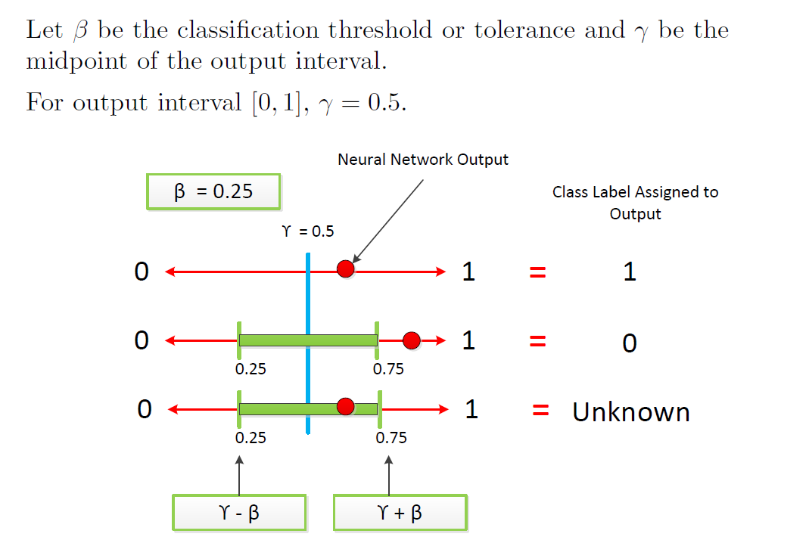
Neural Network Output Threshold

Slide 11
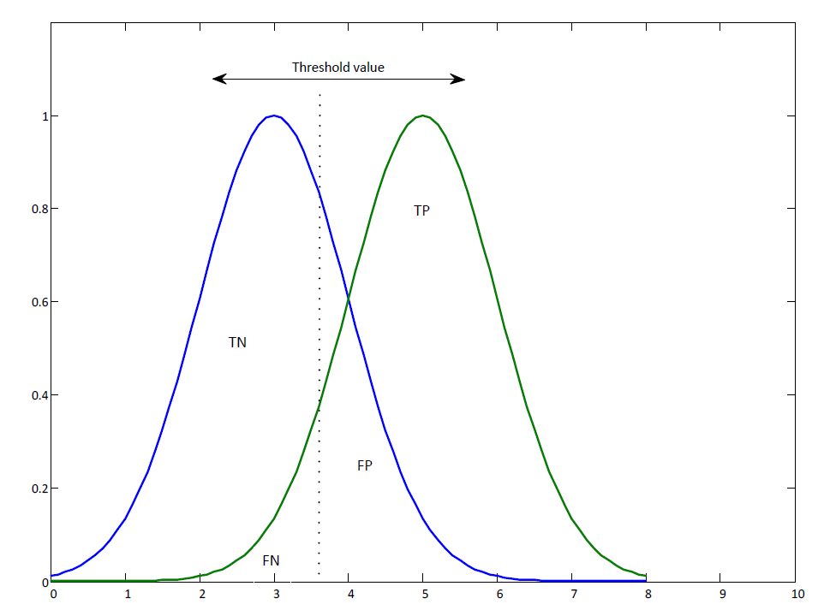
Illustration of Classier Results

Slide 12
Confusion Matrix
The confusion matrix depicts the observed or actual classifications (columns) versus the predicted classification of the model (rows).
The correct classifications, i.e., the true positives and true negatives lie along the diagonal of the confusion matrix.
A perfect classier would have zero false positives and false negatives.
Other model performance metrics can be derived from the elements of the confusion matrix.

Slide 13
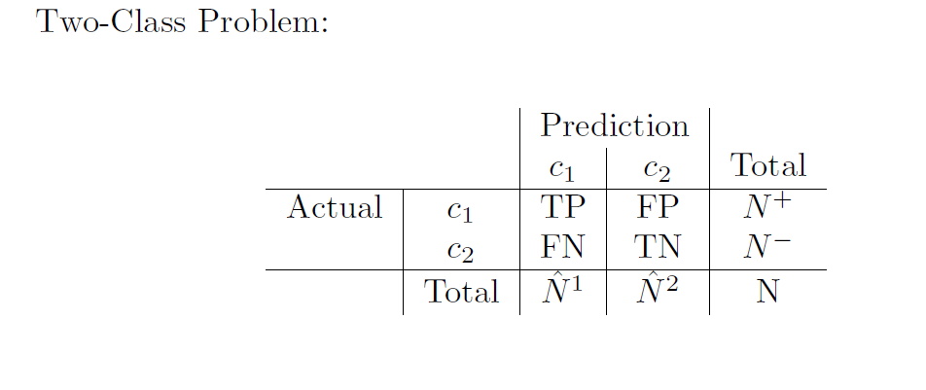
Confusion Matrix (Contd.)

Slide 14
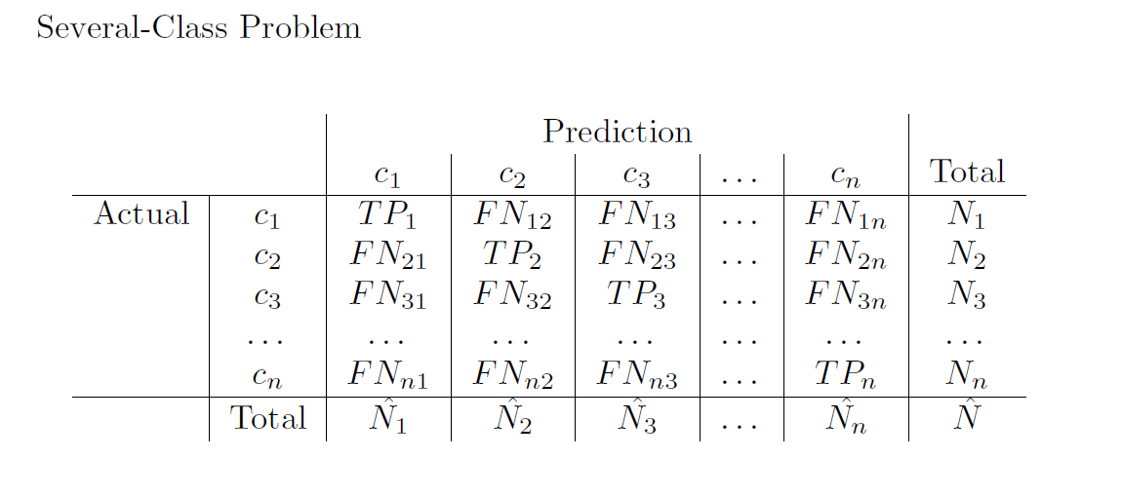
Confusion Matrix (Contd.)

Slide 15
Evaluation Measures Derived from the Confusion Matrix
Based on Confusion Matrix:
Accuracy/Classification Error
Recall/Sensitivity
Specificity
Precision
F-score
Based on Receiver Operator Characteristic (ROC):
Area under the ROC curve (AUC)

Slide 16
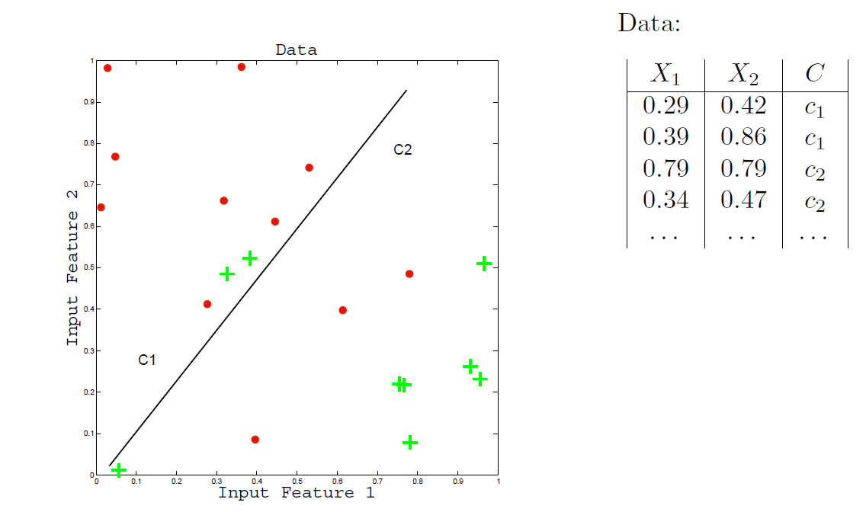
Two-Class Data

Slide 17
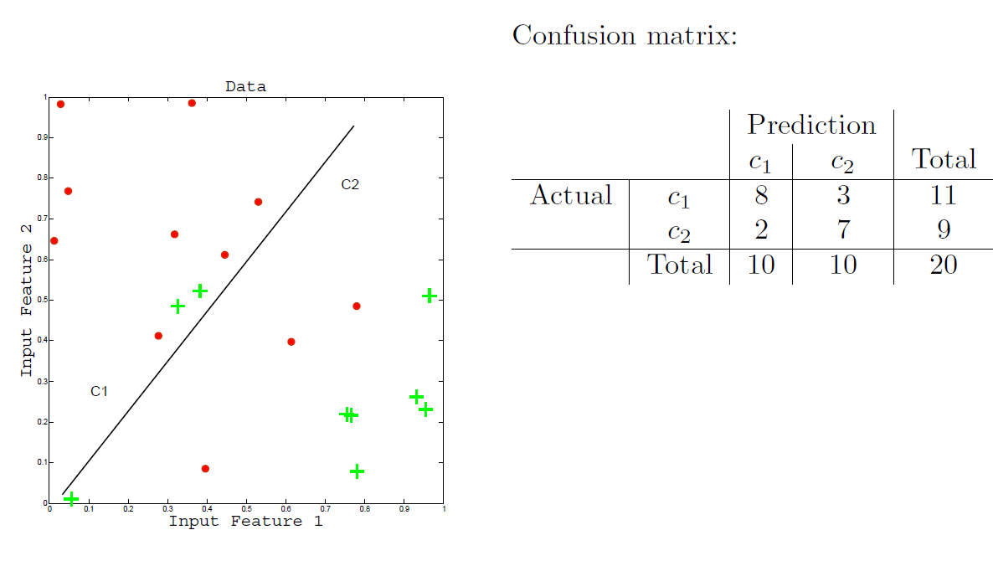
Two-Class Confusion Matrix

Slide 18
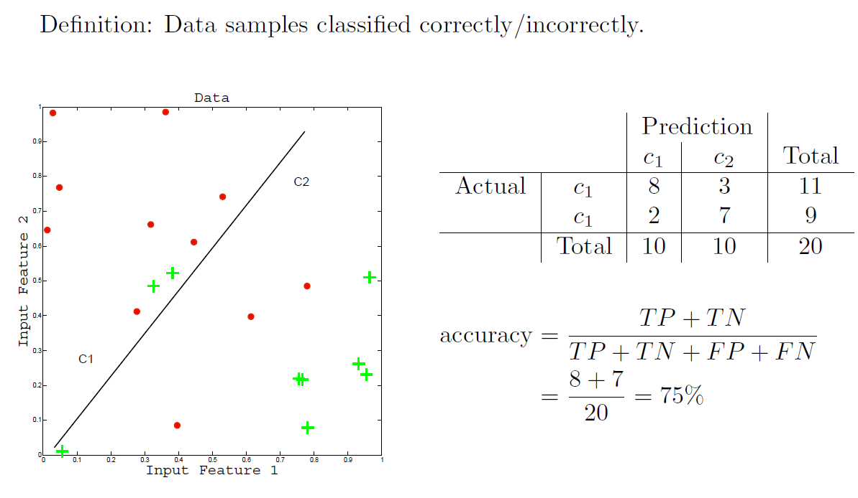
Accuracy/Classification Error

Slide 19
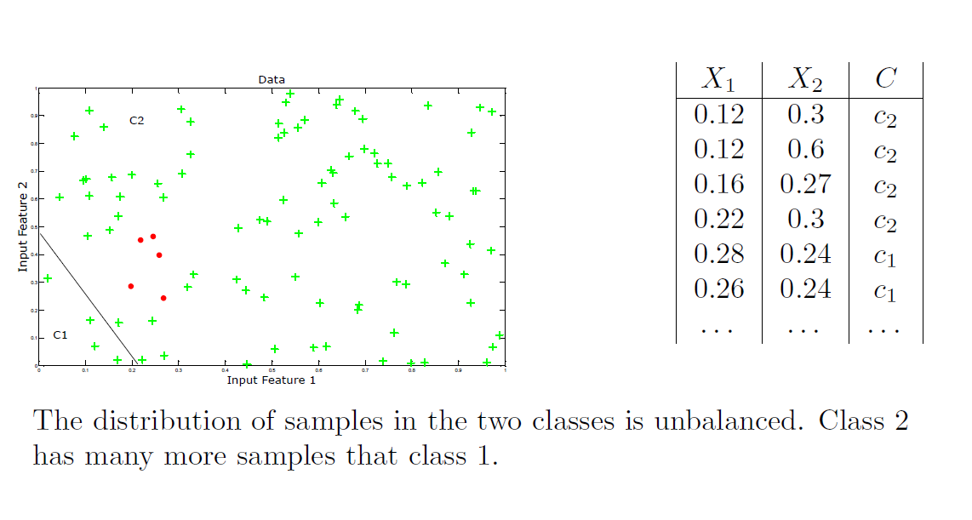
Two Class Problem with Skewed Data

Slide 20
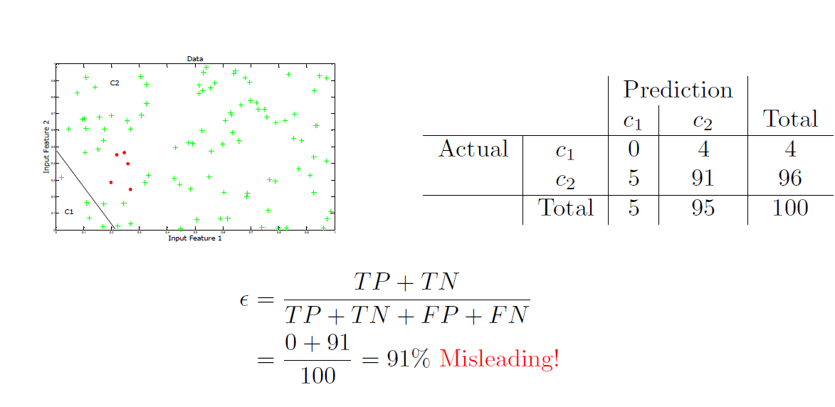
Skewed Data - Classification Accuracy

Slide 21
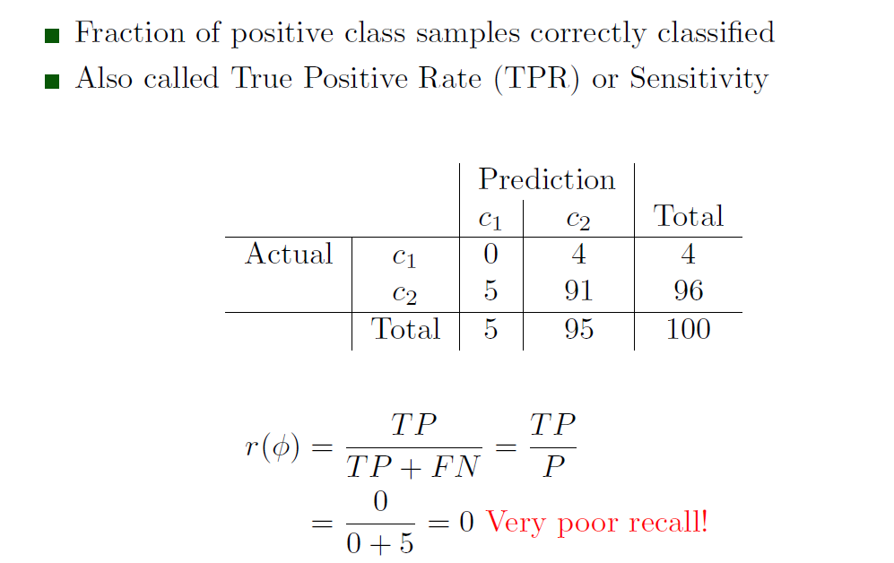
Recall

Slide 22
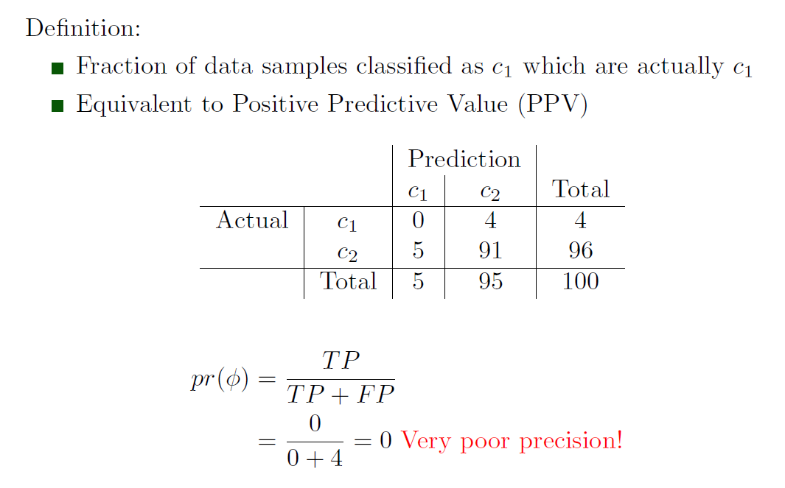
Precision

Slide 23
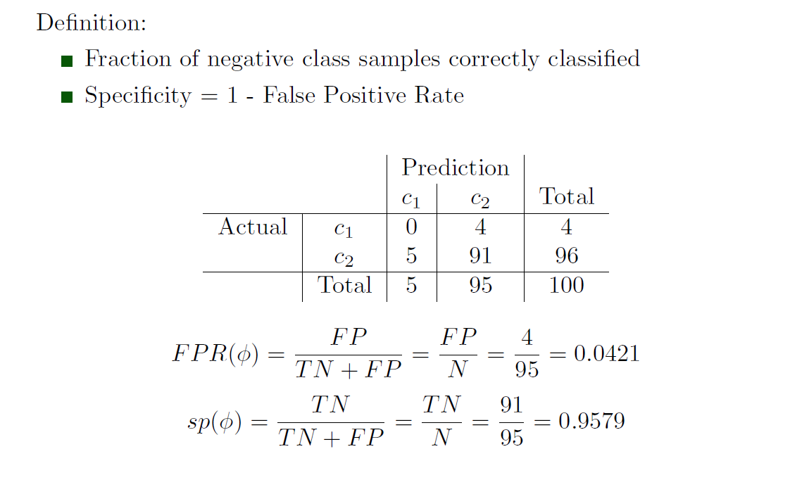
Specificity

Slide 24
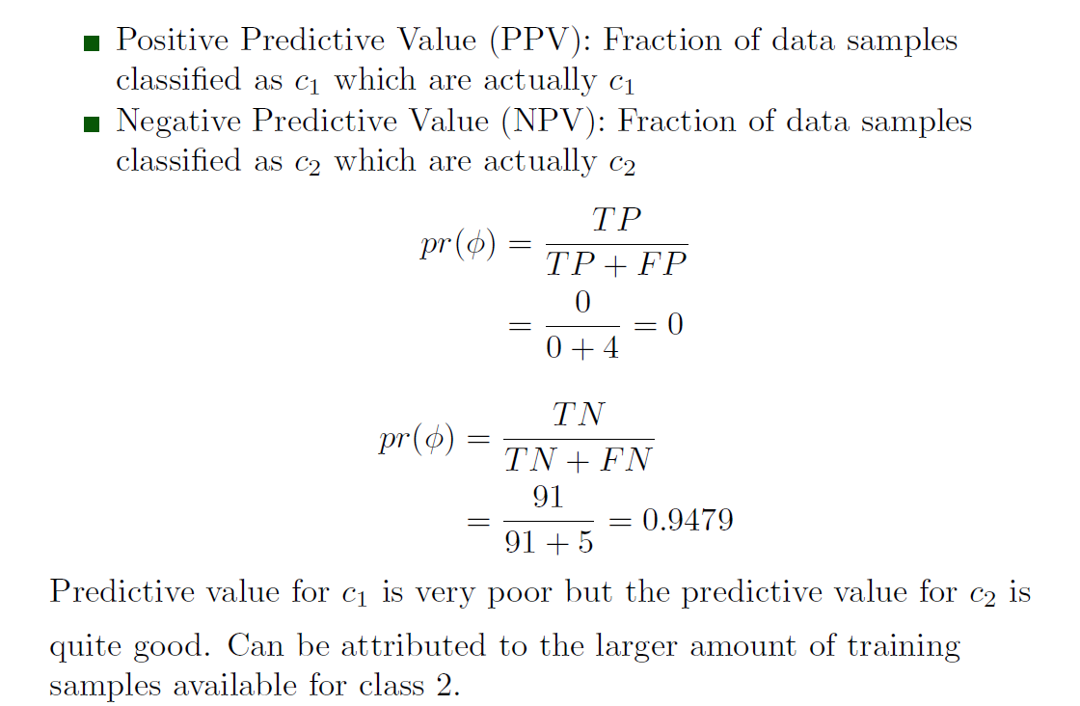
Positive and Negative Predictive Values

Slide 25
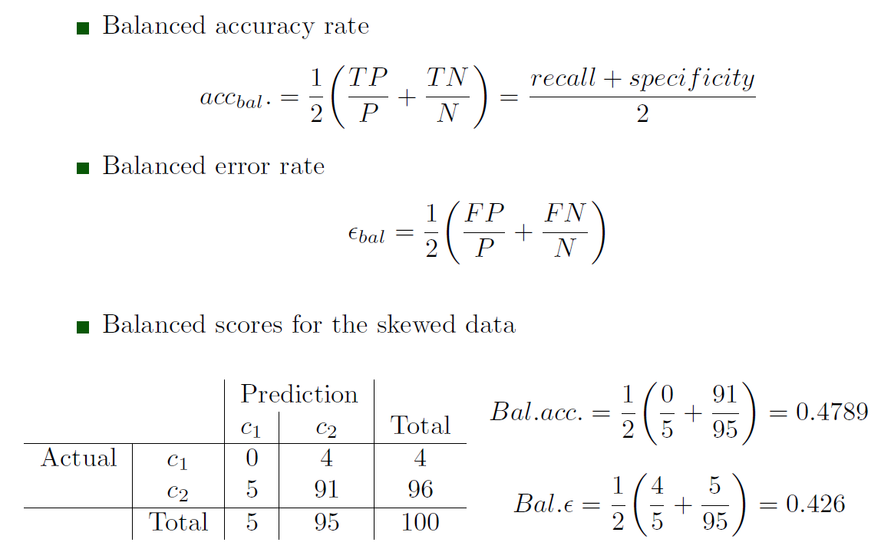
Balanced Scores

Slide 26
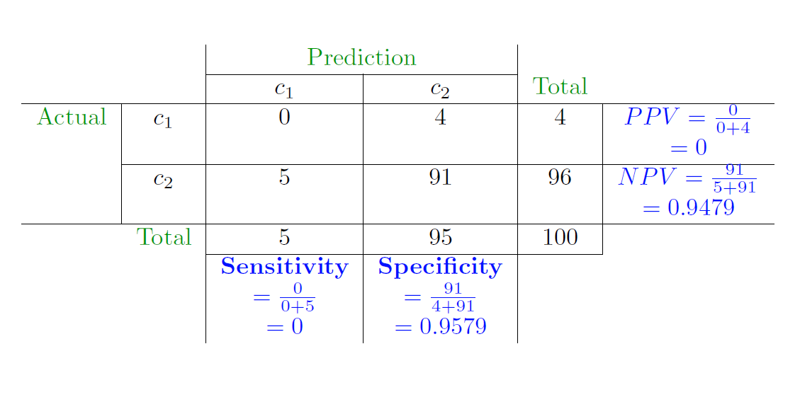
Final Outcomes for Skewed Data Example

Slide 27
Classification Cost
All misclassifications cannot be weighed equally.
Some misclassifications may be more desirable than other
Credit card fraud detection: Some inconvenience to customer is more desirable versus allowing some fraudulent transactions to go undetected.
Diagnosing a healthy patient as sick is preferable to diagnosing a sick patient as healthy.
Some spam in the inbox is preferable to tagging legitimate emails as spam.
In these cases minimizing overall cost of misclassification is preferred over minimizing classification error.

Slide 28
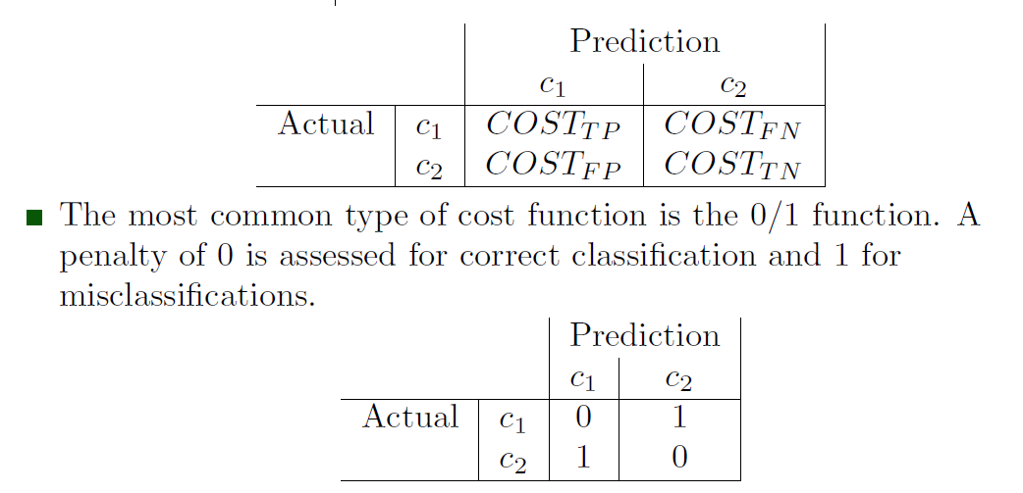
Classification Cost Computation
A cost, utility or penalty value is associated with each class.
Costs for misclassification for different classes will depend on the relative importance of that class.
The cost matrix shows the costs associated with each type of classification error.

Slide 29
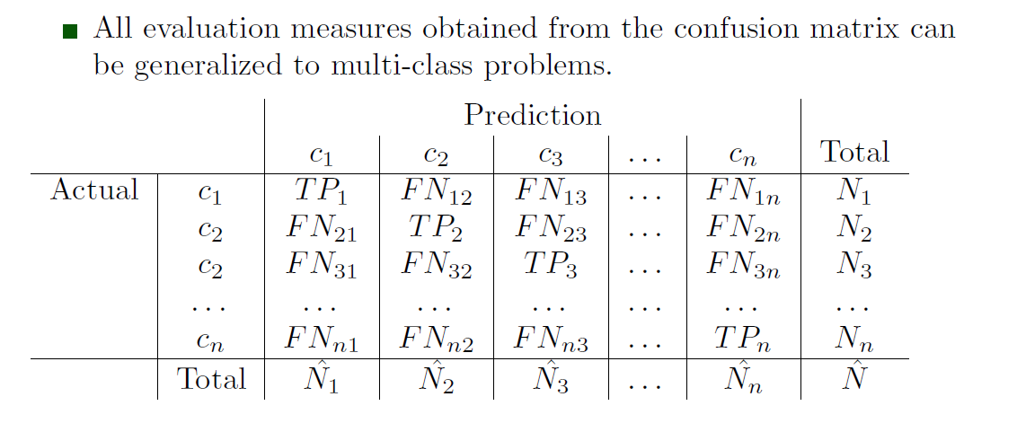
Generalization to Multi-Class Problems

Slide 30
Receiver Operating Characteristics (ROC)
Performance metrics derived from the confusion matrix are sensitive to data anomalies such as class skew.
ROC curves are a graphical tool for evaluating classier performance.
They convey the information from a confusion matrix in a more intuitive fashion.
ROC curves are plots of the true positive rate (sensitivity) versus the false positive rate (1-specificity) for different values of a threshold parameter.
The Area Under the ROC Curve (AUC) is a measure of how well a model can distinguish between two classes.
A valid AUC estimate can be interpreted as the probability that the classier will assign a higher score to a randomly chosen positive sample than to a randomly chosen negative sample.

Slide 31
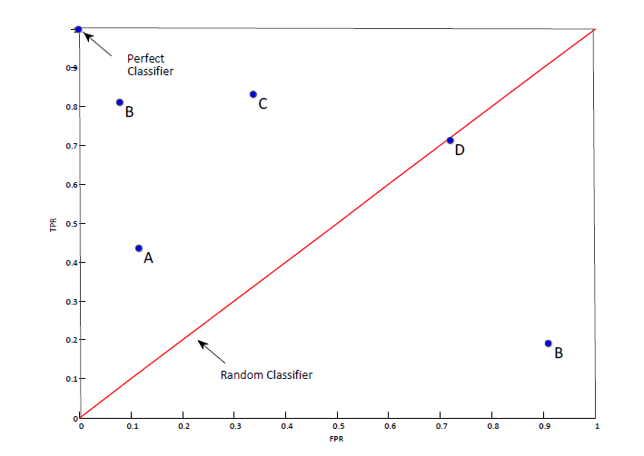
ROC Plot
Chance Classifier: equal number of false positives and true positives.
Perfect Classifier: no false positives
Below red line: worse than random performance

Slide 32
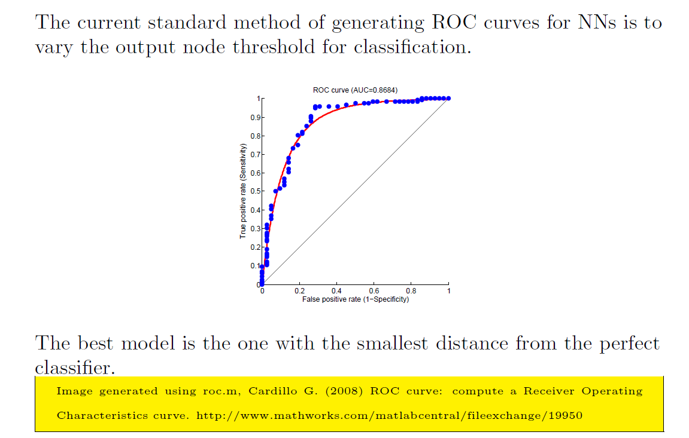
ROC Example

Slide 33
Steps for Plotting an ROC Curve for NN
Statistical classifiers have underlying parameters that can be varied to generate ROC curves.
For nonparametric models like ANN, ROC curves can be generated by varying the output threshold.
The NN model of interest must be trained before the ROC curve can be generated.
Output node thresholding:
The threshold for the output units of the NN are varied in the interval [0, 1].
For each value of the threshold, inputs that produce outputs greater than the threshold are classified into the true class, and others into the false class.
A set of operating points (TPR ad FPR) are obtained for varying thresholds and plotted as an ROC curve.

Slide 34
Model Selection
Given two or more models, how can we pick one to deploy based on ROC curves?
The model with the curve closest to the perfect classier (top left corner of the plot) has superior classification performance - commits fewer false positives
Selection of the best model depends on the tradeoff between the `costs' of false positives versus false negatives.
Ensuring zero fraud even if it a small percentage of legal transactions get flagged as fraudulent -- better fraud prevention
Allowing a small percentage of spam in the inbox, as long as no legitimate emails are flagged as spam --better customer experience

Slide 35
References
[1] Han and Kamber, Data Mining: Concepts and Techniques, 2nd Ed., Morgan Kaufmann, 2006.
[2] Simon Haykin, Neural Networks and Learning Machines, 3rd Ed., 2008.
[3] Lozano et. al., Classier performance evaluation and comparison, ICMLA 2010,
http://www.icmla-conference.org/icmla10/CFP Tutorial les/jose.pdf.
[4] Bishop, Neural Networks for Pattern Recognition, Clarendon Press, Oxford, 1995.
All content and images adapted from reference 2 unless specified otherwise.

Slide 36
Introduction
Support Vector Machine (SVM) is a binary learning machine with some highly elegant properties
has sound mathematical basis
very successful real world applications
most popularly used algorithm for text processing
SVMs have some inherent advantages over MLPs trained with backpropagation
Search for the optimal solution; not a greedy search
Do not get stuck in local minima
Do not suffer from the curse of dimensionality

Slide 37
Key Ideas Behind SVMs
Key Idea
Given a linearly separable training sample, the SVM constructs a separating hyperplane as a decision surface where the margin of separation between positive and negative examples is maximized.
This basic idea can be extended to non-separable patterns by mapping the original data into a new space.
Support vectors are data points extracted by the learning algorithm from the training sample itself.

Slide 38
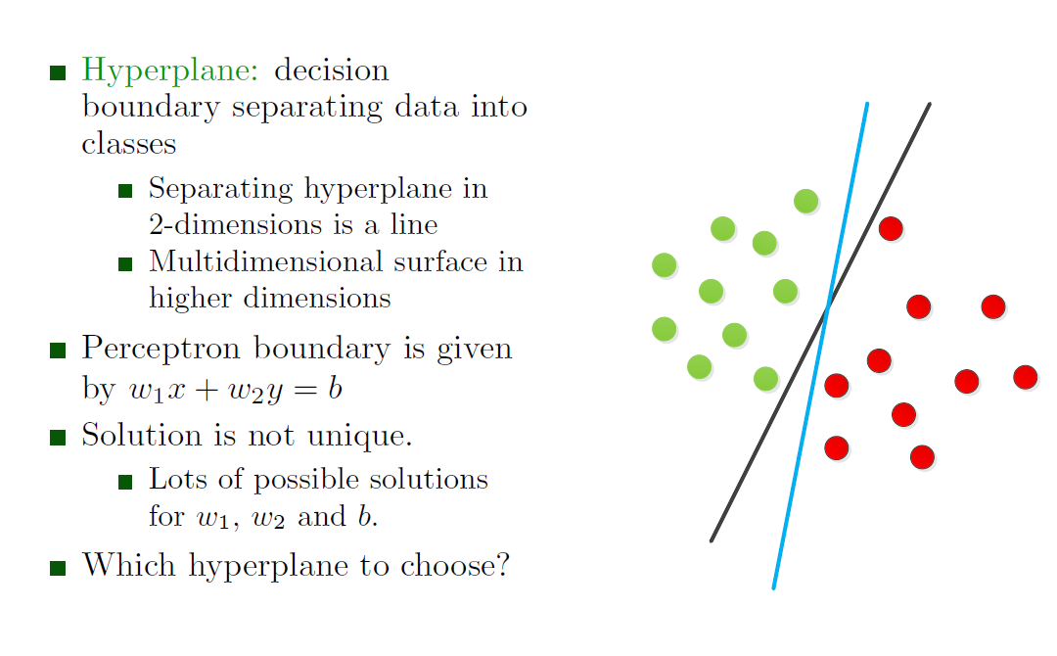
Recap: Separating Hyperplane

Slide 39
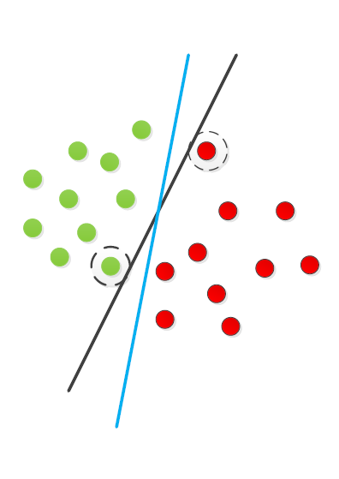
Optimal Hyperplane
SVMs find the optimal separating hyperplane
How should optimality be determined?
Can use distance from the data points as a measure
Which points should affect optimality?
All points in a class: Linear regression, Naive Bayes
Only the points closest to the decision boundary which are hardest to classify: Support vector machines

Slide 40
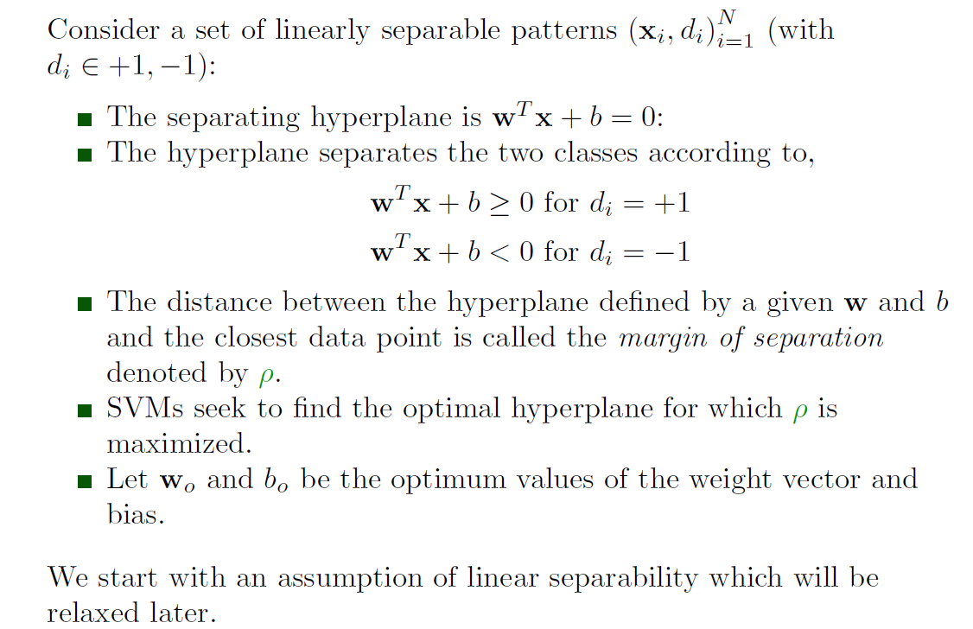
Optimal Hyperplane for Linearly Separable Patterns

Slide 41
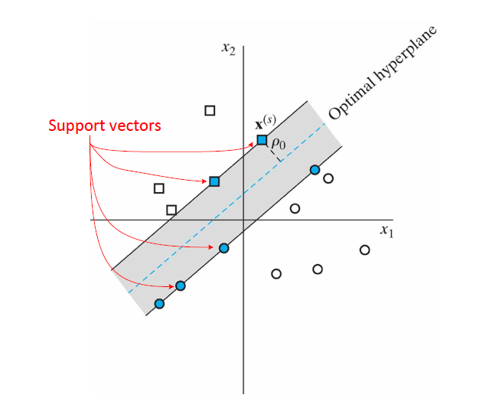
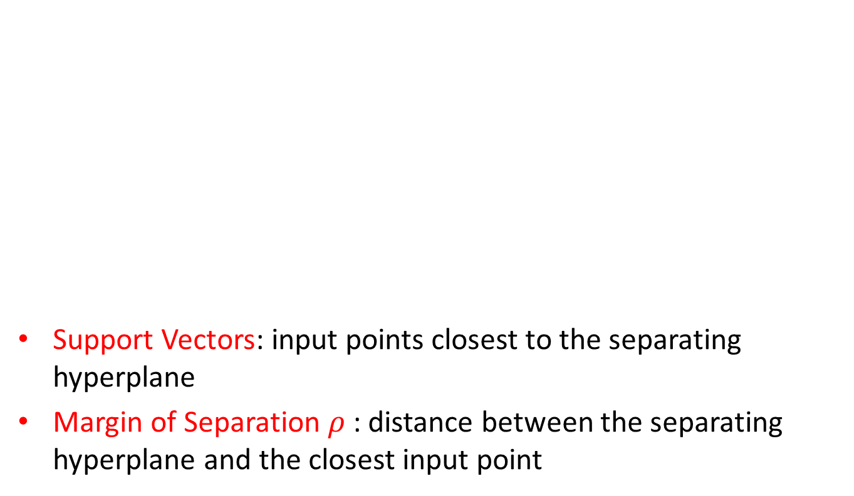
Illustration of the Optimal Hyperplane
Support Vectors: input points closest to the separating hyperplane
Margin of Separation $ρ$ : distance between the separating hyperplane and the closest input point

Slide 42
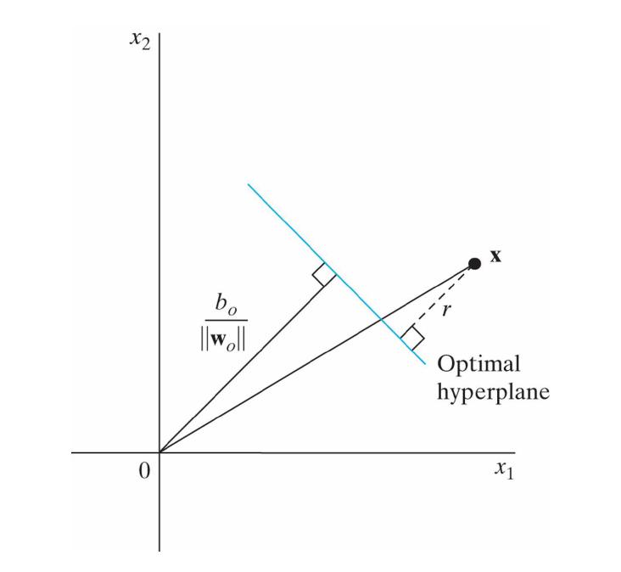
Distance to the Optimal Hyperplane Illustrated

Slide 43
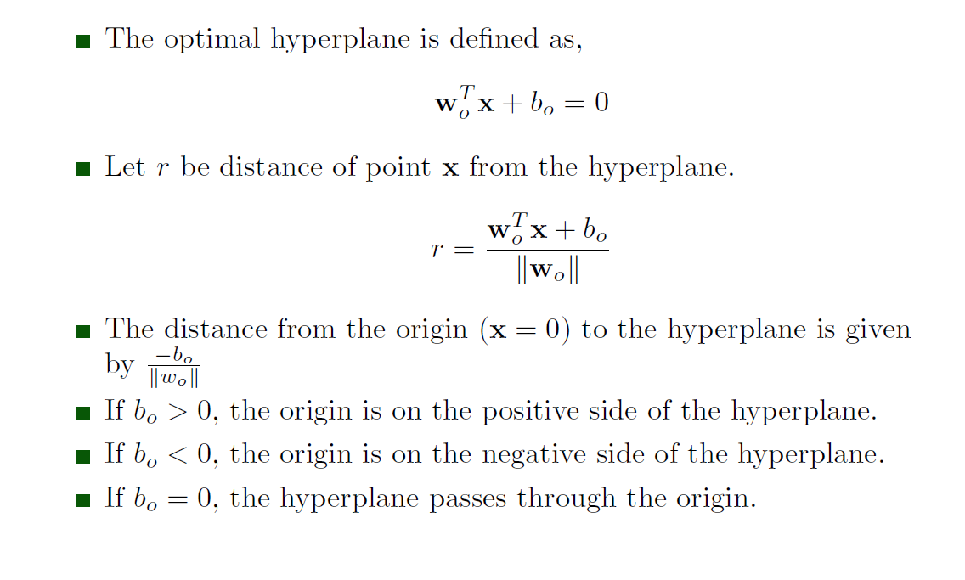
Distance to the Optimal Hyperplane

Slide 44
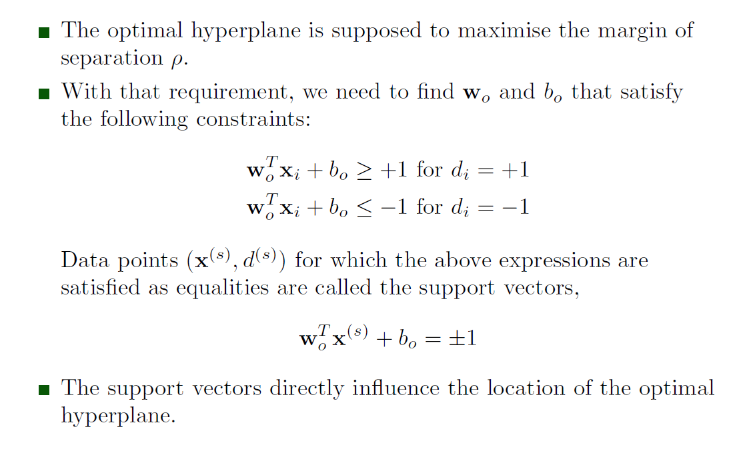
Optimal Hyperplane and Support Vectors

Slide 45
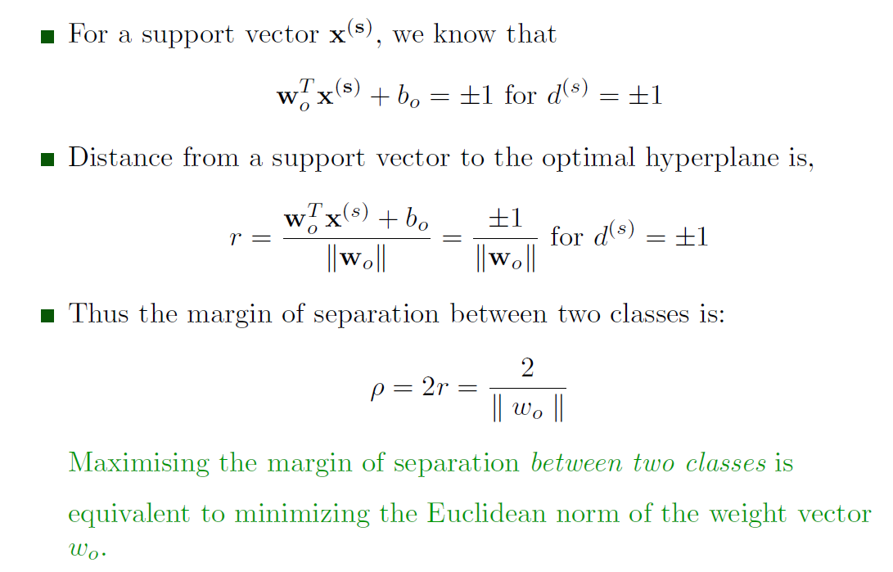
Optimal Hyperplane and Support Vectors contd.

Slide 46
Constrained Optimization Problem
SVM solutions are formulated as convex optimization problems. The four major steps of the formulation are,
Define the problem of finding the optimal hyperplane as a constrained optimization problem in weight space.
Construct the Lagrangian function of the optimization problem.
Derive conditions for optimality.
Solve the optimization problem using the method of Lagrange multipliers.

Slide 47
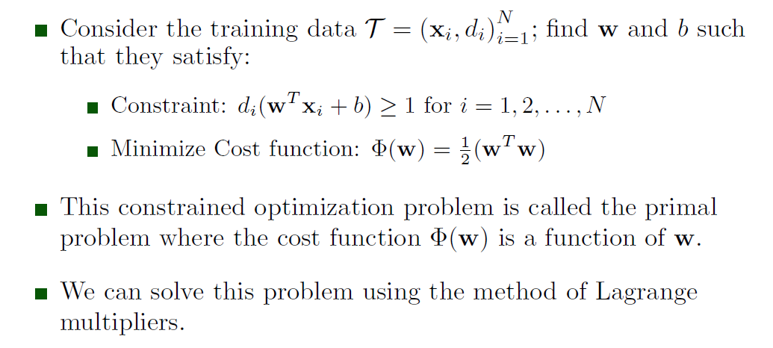
Constrained Optimization Problem contd.

Slide 48
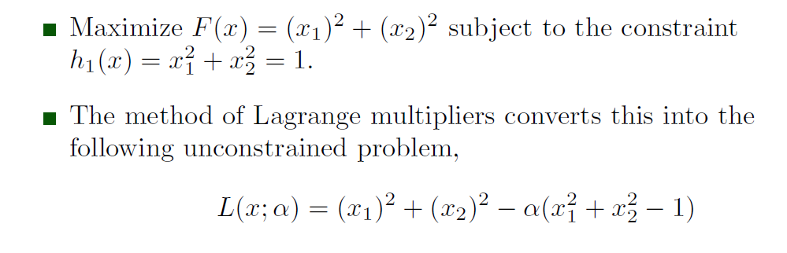
Method of Lagrange Multipliers
Turn a constrained optimization problem into and unconstrained optimization problem by absorbing the constraints into the cost function, weighted by the Lagrange multipliers.
Example: Adapted from Ravindran et. al., Engineering Optimization: Methods and Applications, Wiley, 2006, pp. 221-222)

Slide 49
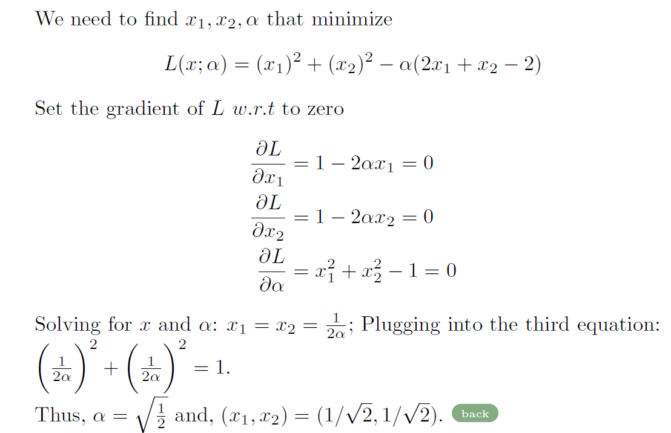
Lagrange Multipliers contd.

Slide 50
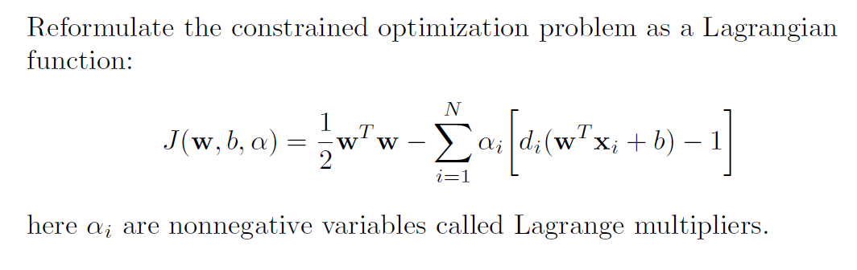
Constructing the Lagrangian Function

Slide 51
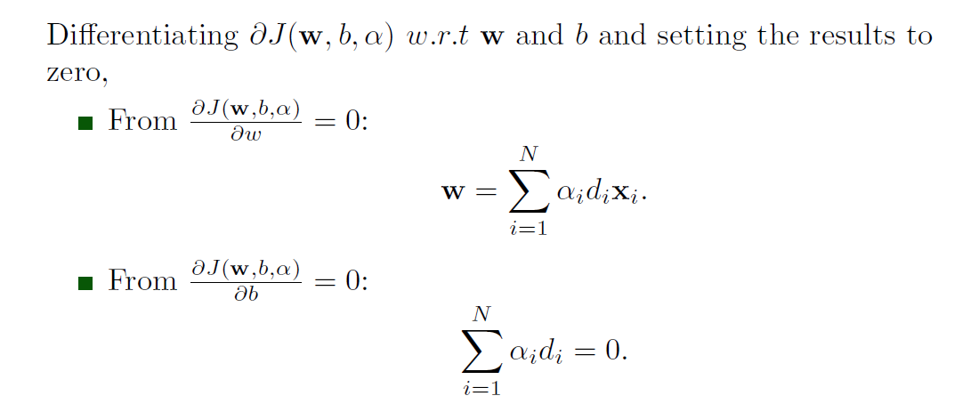
Conditions of Optimality

Slide 52
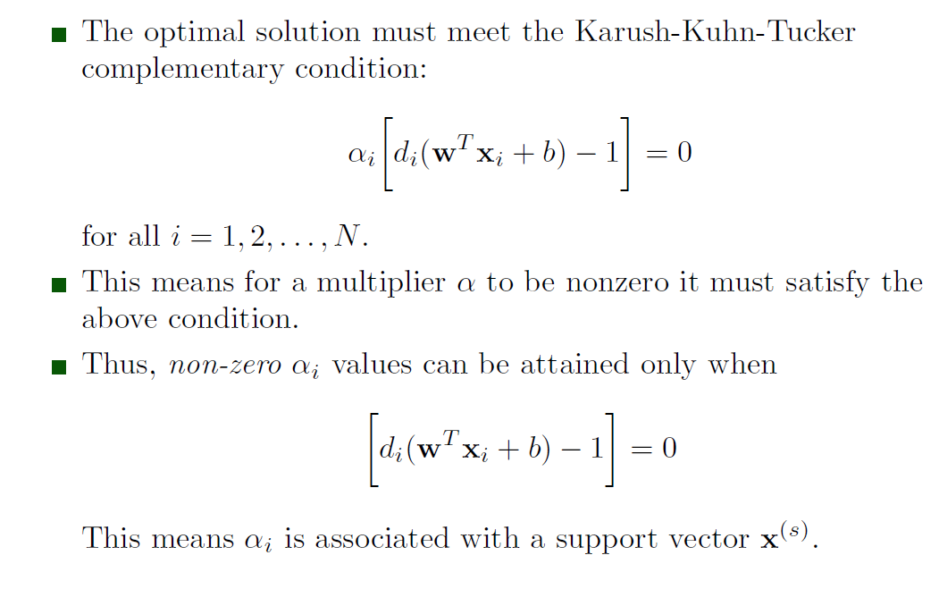
Conditions for Optimality contd.

Slide 53
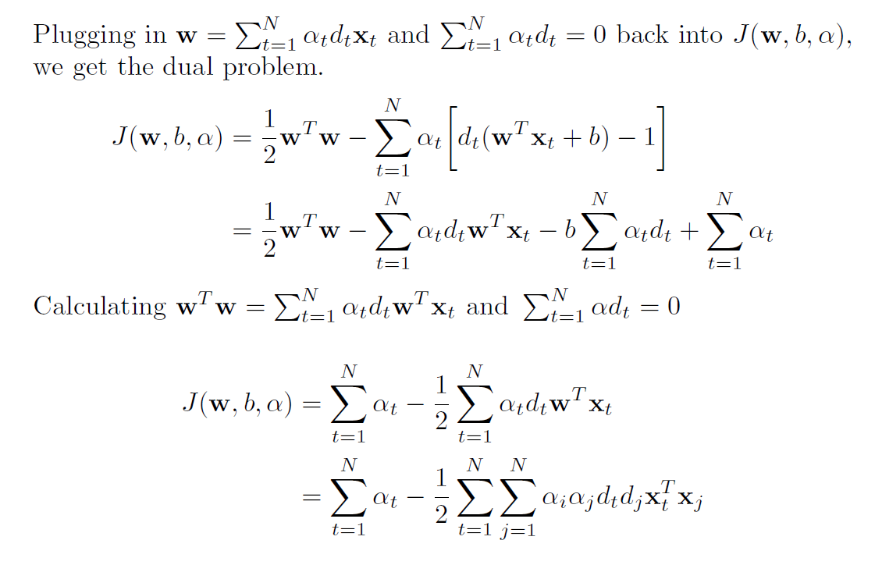
Postulating the Dual Problem

Slide 54
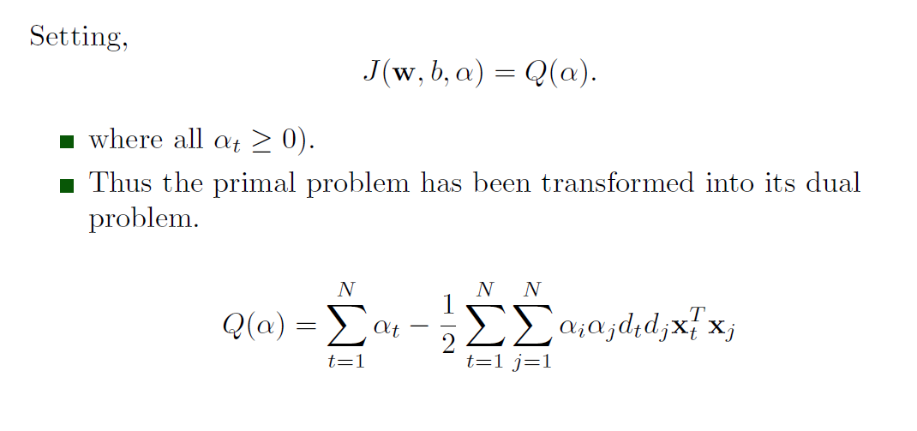
Postulating the Dual Problem

Slide 55
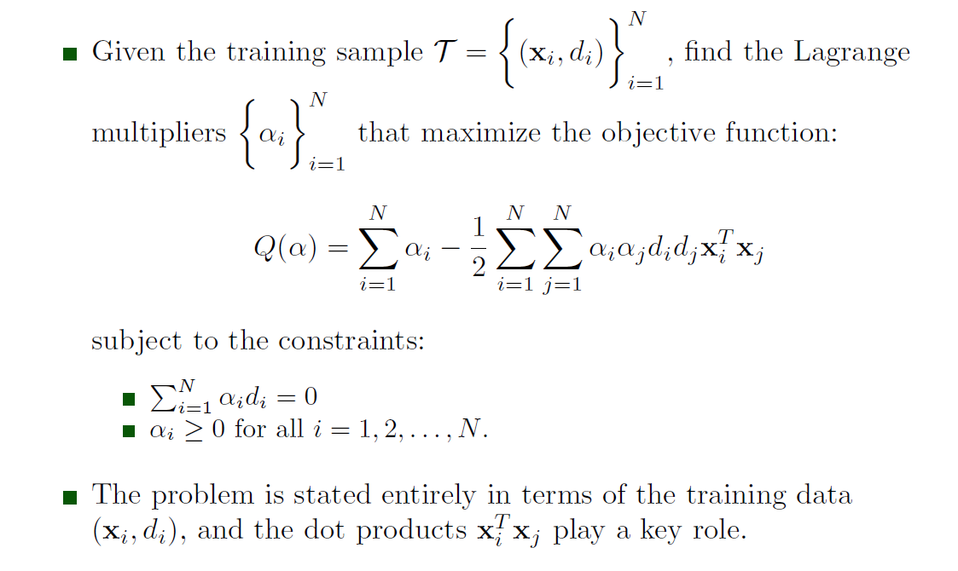
Stating the Dual Problem

Slide 56
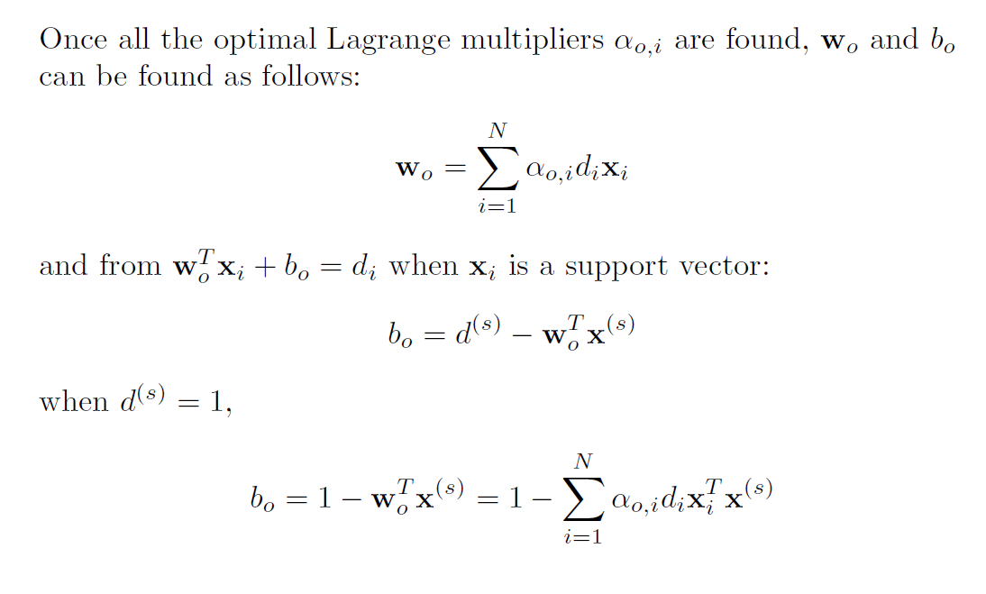
Solution to the Optimization Problem

Slide 57
SVM for Non-separable Patterns
For nonseparable patterns, it is not possible to construct a hyperplane without classification errors.
Objective is to minimize the probability of classification errors.
Use Cover's theorem to construct a nonlinear mapping of an input vector to a high-dimensional feature space
Construct an optimal hyperplane for separating the features identified by the nonlinear transformation.

Slide 58
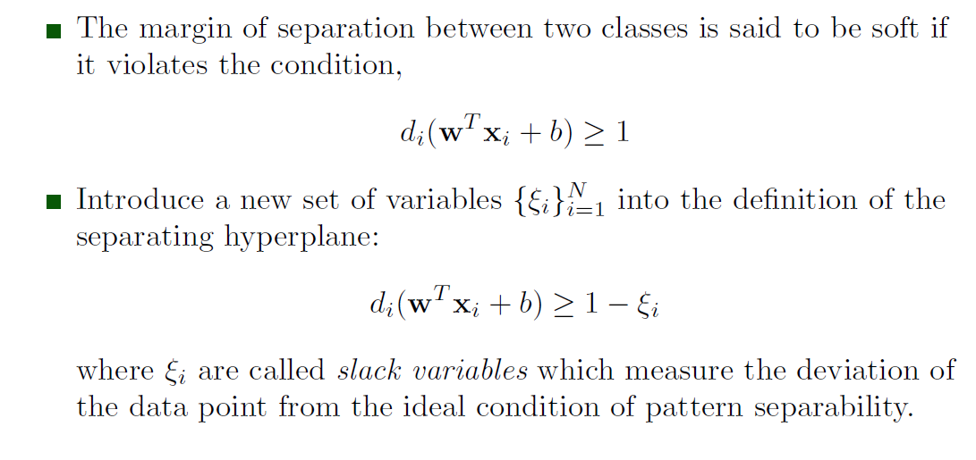
Soft-margin Classification

Slide 59
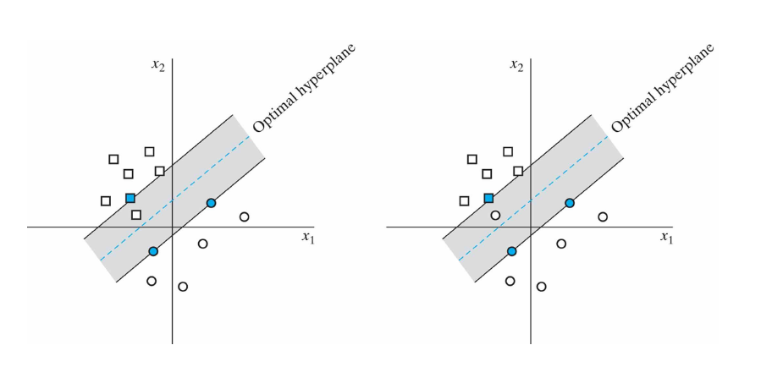
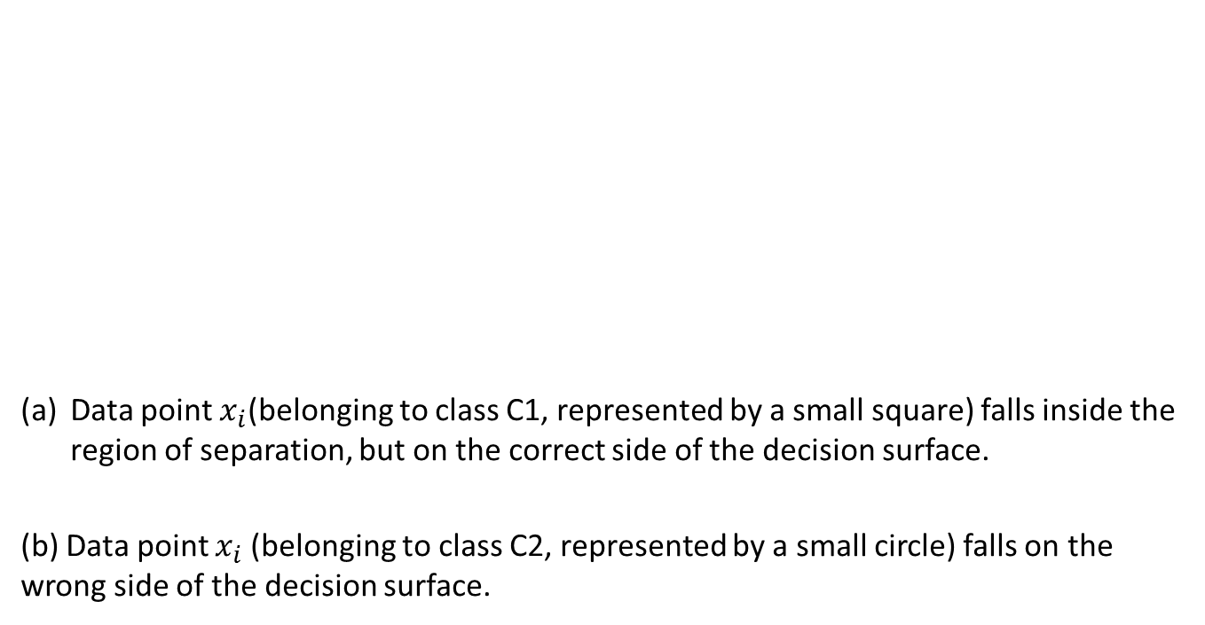
Soft Margin of Separation
Data point $x_{i}$(belonging to class C1, represented by a small square) falls inside the region of separation, but on the correct side of the decision surface.
(b) Data point $x_{i}$(belonging to class C2, represented by a small circle) falls on the wrong side of the decision surface.

Slide 60
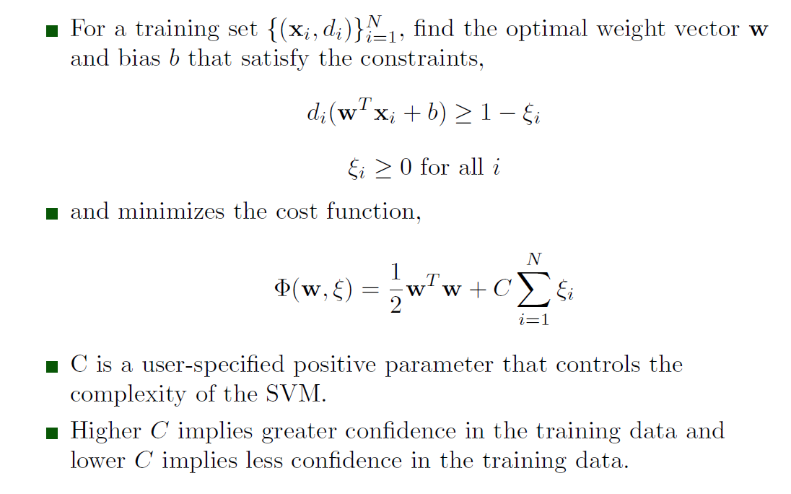
Primal Problem for Nonseparable Case

Slide 61
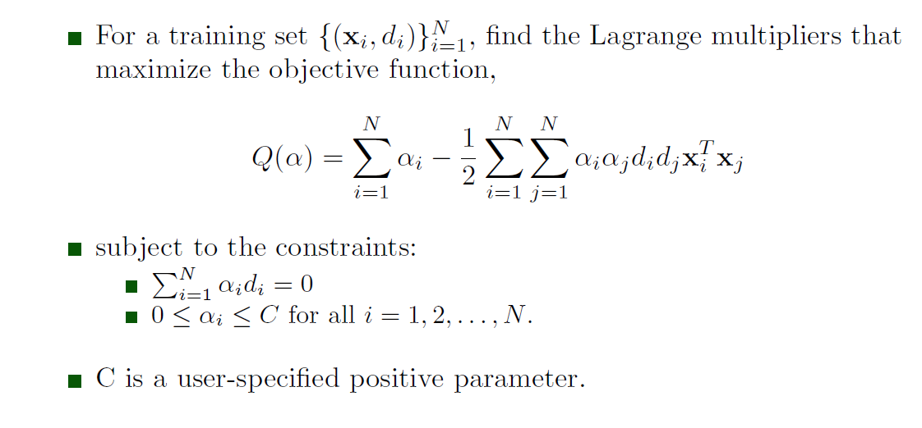
Dual Problem for Non-separable Case

Slide 62
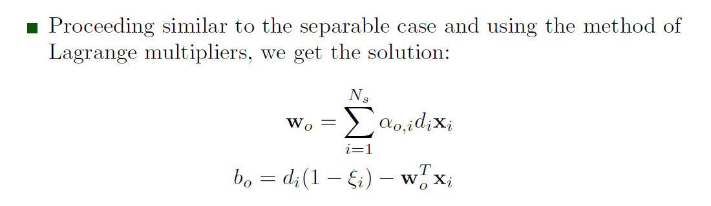
Solution of the Nonseparable Case

Slide 63
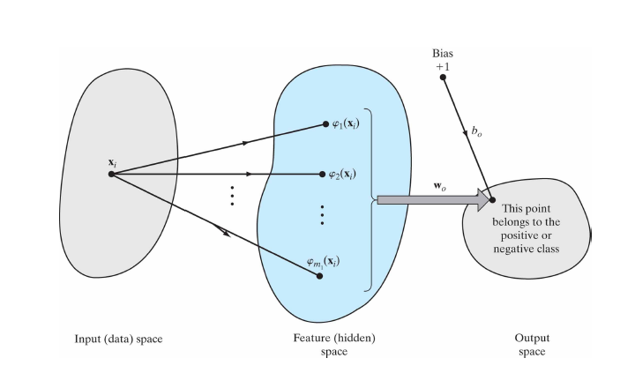
Underlying Philosophy of SVM for Pattern Classification
SVM operation hinges on two mathematical operations:
(i) Nonlinear mapping from the input space to a high-dimensional feature space.
(ii) Construction of a hyperplane for separating the features into classes.

Slide 64
Determining the Size of the Hidden Space
The number of features in the hidden space is determine by the number of support vectors.
Thus, SVMs provide an analytical method for finding the optimal size of the hidden space, or the optimal number of hidden neurons.
This is a significant improvement over MLPs trained with backpropagation and Radial-basis function networks.
Optimality of the classification task is assured!

Slide 65
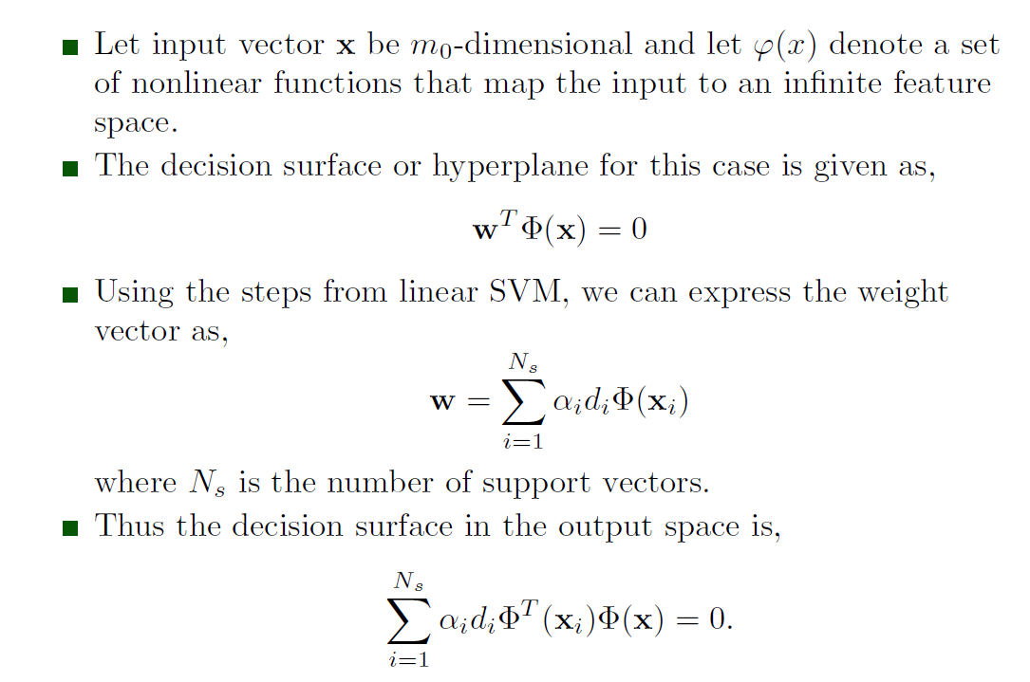
SVM as a Kernel Machine

Slide 66
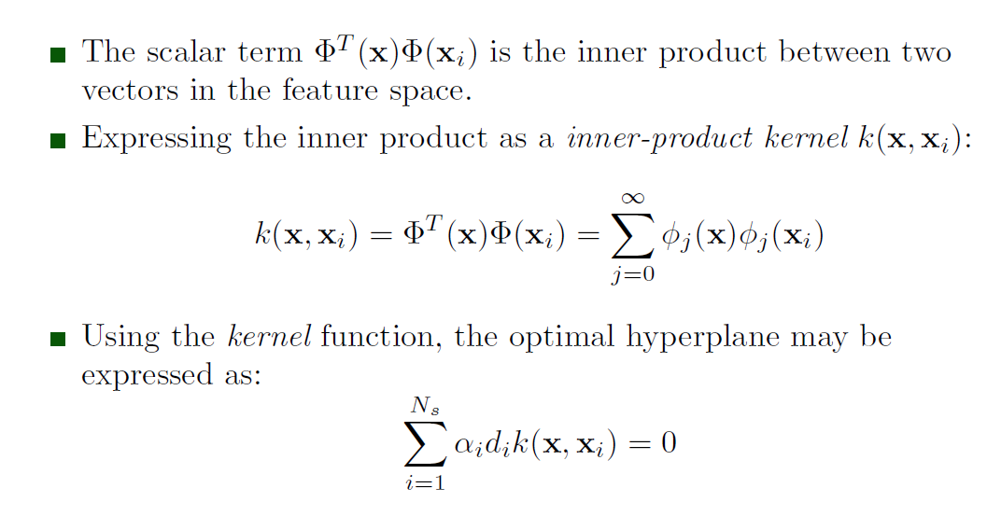
Inner-product Kernel

Slide 67
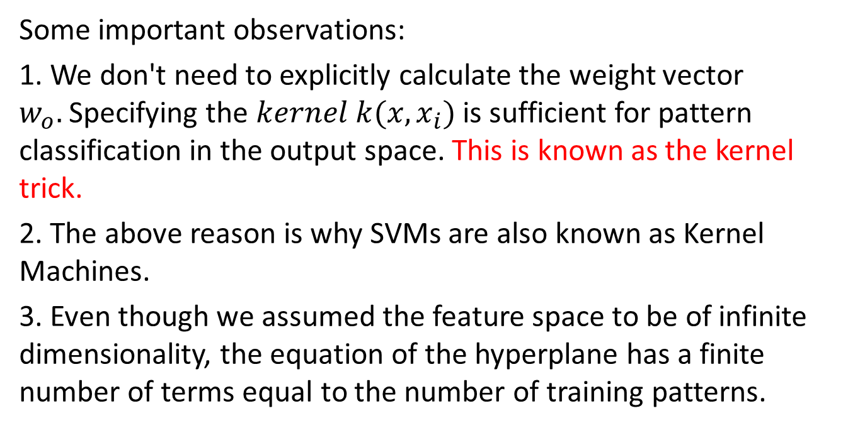
The Kernel Trick
Some important observations:
1. We don't need to explicitly calculate the weight vector $w_{o}.$Specifying the $kernel k(x,x_{i})$ is sufficient for pattern classification in the output space. This is known as the kernel trick.
2. The above reason is why SVMs are also known as Kernel Machines.
3. Even though we assumed the feature space to be of infinite dimensionality, the equation of the hyperplane has a finite number of terms equal to the number of training patterns.

Slide 68
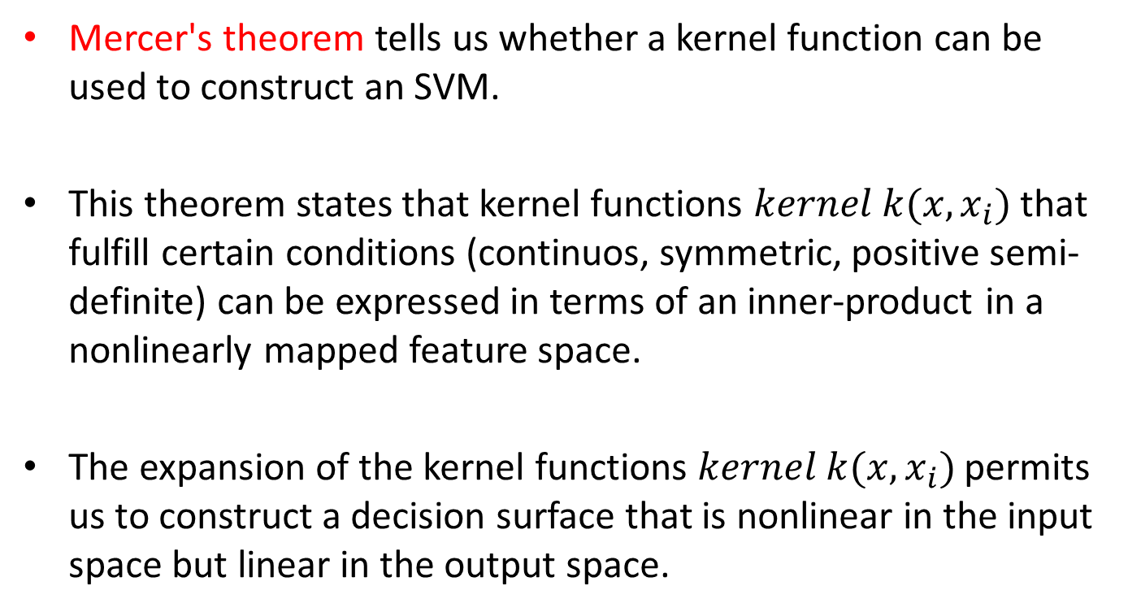
Selecting Kernel Functions
Mercer's theorem tells us whether a kernel function can be used to construct an SVM.
This theorem states that kernel functions $kernel k(x,x_{i})$that fulfill certain conditions (continuos, symmetric, positive semi-definite) can be expressed in terms of an inner-product in a nonlinearly mapped feature space.
The expansion of the kernel functions $kernel k(x,x_{i})$permits us to construct a decision surface that is nonlinear in the input space but linear in the output space.

Slide 69
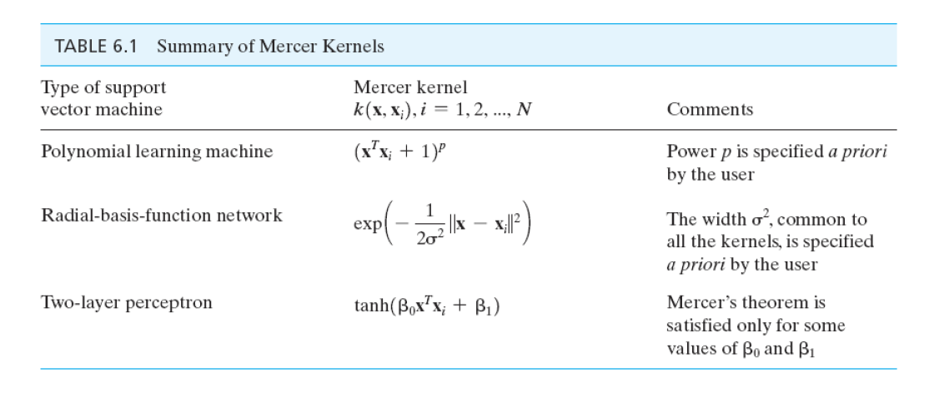
Examples of Kernel Functions Usable for SVMs

Slide 70

SVM Solution Using the Kernel Function

Slide 71

XOR Problem
Objective: To design an SVM to solve the XOR problem.

Slide 72

XOR Problem

Slide 73

XOR Problem

Slide 74

XOR Problem

Slide 75

XOR Problem

Slide 76

XOR Problem

Slide 77

XOR Problem

Slide 78

XOR Problem: Solution

Slide 79
Final Project Report and Exam
Final project report is due on May 4, 2018 at 4:00 PM US CDT
Final Exam will be posted on blackboard on May 4, 2018 at 4:00 PM US CDT and will be due on May 7, 2018 at 11:59 PM your local time.

Slide 80
Final Project Report and Exam
Final project report is due on May 5, 2017 at 4:00 PM US CDT
Final Exam will be posted on blackboard on May 5, 2017 at 4:00 PM US CDT and will be due on May 8, 2017 at 11:59 PM your local time.

